Slide 1
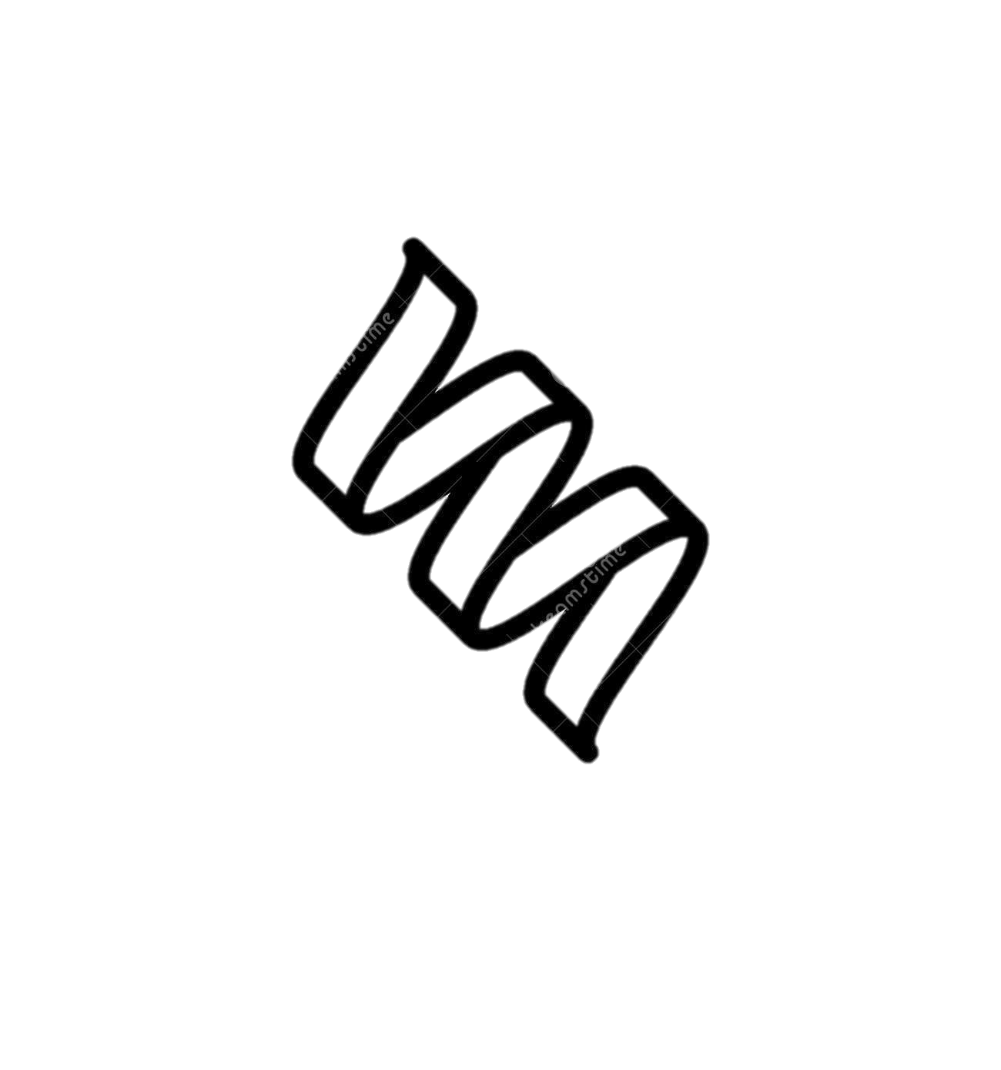
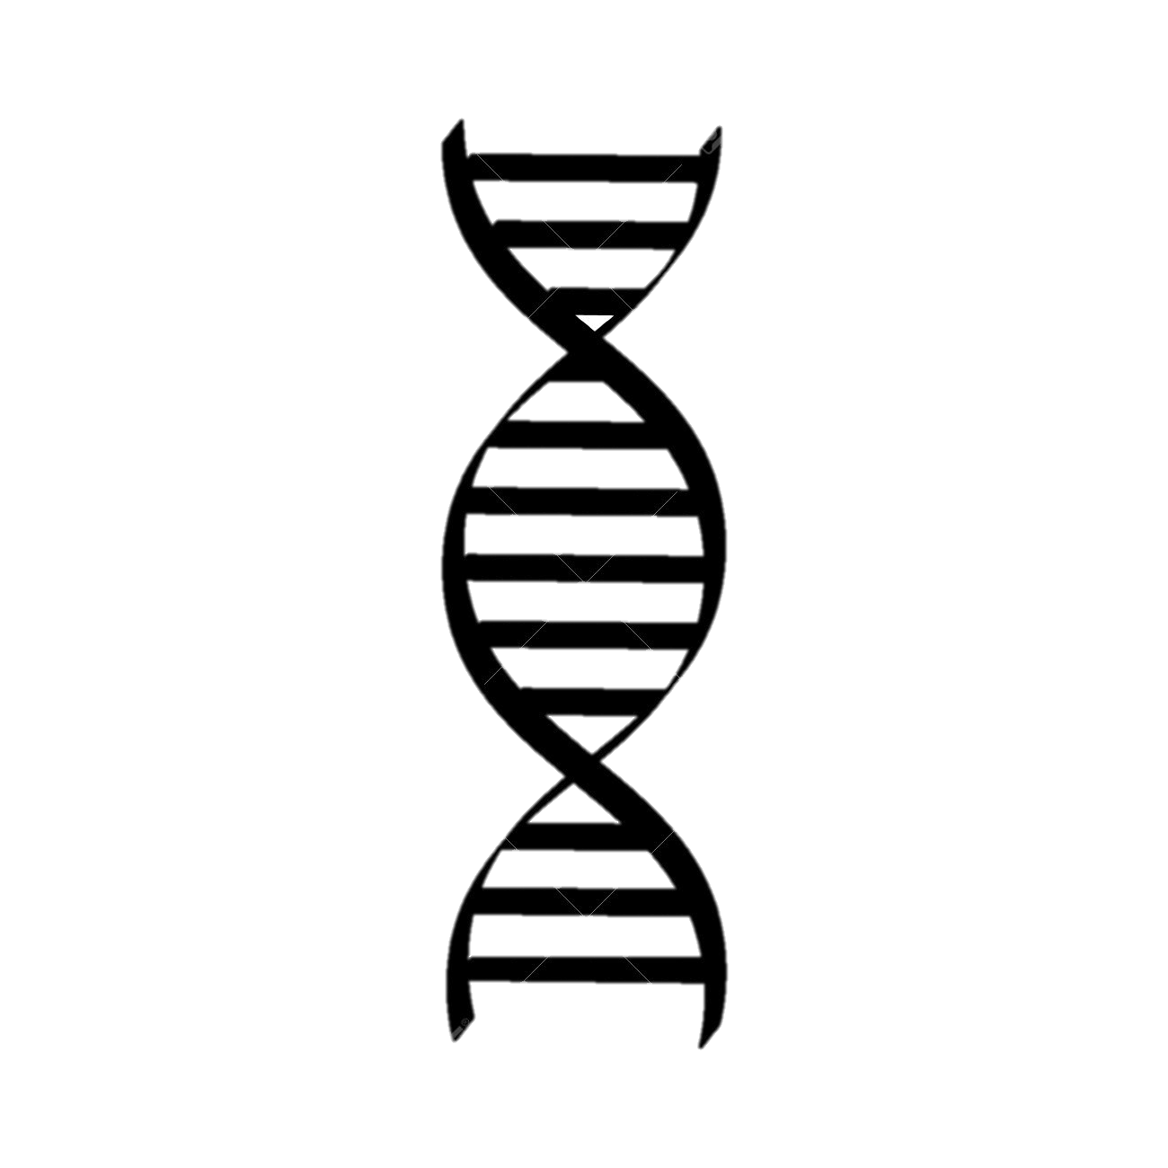


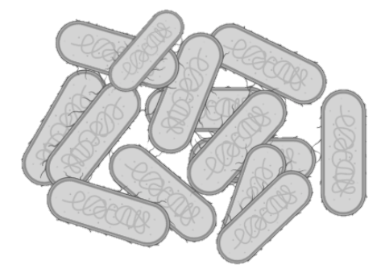


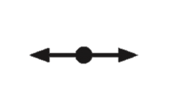
METABOLISM
PROTEIN SYNTHESIS
Ribosome synthesis
Translation elongation and termination
Spermidine transport
Modification and processing of tRNAs
Aerobia → Anaerobia
O₂
STRESS RESISTANCE SYSTEMS
DNA REPLICATION
Acid resistance system
Oxidative stress system
DNA and RNA damage
Response to heat
General stress response
Nucleotide synthesis and recycling
RNase HI &HII
UP
REGULATION
DOWN
REGULATION
CELL DIVISION
Division septum site selection
Regulation of division septum assembly
Regulation of cell division
ANTIBIOTIC RECALCITRANCE
MAINTENANCE OF OUTER MEMBRANE
tRNAs modification and processing
Activation of multiple TA systems
Induction of SUF system
Lipid II transport
Peptidoglycan biosynthesis
Degradation and turnover of Peptidoglycan components
Ag43 SPECIFIC
Increase in number of genes involve in anaerobia
Induction of TA systems
More tRNAs are downregulated
Decrease in motility and cell surface fimbriae

